Slide 1

AI’s Impact on Consumption and Manufacturing
Presented By –
Krishna Agrawal

Slide 2


Agenda
1
Background
4
Responsible Enterprise
2
Why should organizations adopt SDG´s?
Main Use Cases of AI in Consumption and Manufacturing
5
3
Positive and Negative Impact of AI
6
O9 Solutions Case Study

Slide 3

Background
Sustainable Development Goal 12: Sustainable Consumption and Production
‘
‘
Sustainable Consumption and Production is about doing more and better with less. It is also about decoupling economic growth from environmental degradation, increasing resource efficiency and promoting sustainable lifestyles. UN
‘
‘
The global economy is passing through several changes to achieve the 2030 Agenda. For instance, the incorporation of Big Data and AI systems into business operations and internal changes (strategies) was caused by the economic, social, and environmental issues, encouraging businesses to become socially responsible and promote Sustainable consumption and production.
Companies require cooperation from various internal and external stakeholders (governments, customers, NGO, competitors and suppliers, employees, unions) to address their sustainability challenges. Moreover, some SDGs deal with positive and negative effects of human and corporate activities. AI strategy must also be viewed through this lens to gauge its influence on the world.

Slide 4
According to the PWC 2018 Challenge Report, 69% of corporations mentioned the adoption of SDGs in their annual reports, meaning that SDG’s have broken into the business mainstream. This implies that firms are addressing certain SDG´s with the use of Data Strategy and AI Operations to contribute with the 2030 Agenda to create a more sustainable business environment.
Notes:
PWC (2019). [online] Available at: https://www.pwc.com/gx/en/sustainability/SDG/sdg-reporting-2018.pdf [Accessed 24 Nov. 2021].

Slide 5
Why should Organizations adopt SDGs?
The 17 SDGs demonstrate the real-world issues, that directly impact the business world, this means, that corporations are influenced by the environmental and social challenges addressed by each Goal (PWC 2018).
External Pressure
The actual organizational environment is affected by a variety of factors, that influence the business operations making corporations to come up with new strategies and ideas to operate under the new circumstances.
The external stakeholders create internal and external pressure to the business. These stakeholders can be social actors, pressure groups, local communities, NGO, customers, and governments.
They work together with corporations to create awareness and generate a more sustainable environment.
Internal Pressure
The internal pressures come from inside the business operations, they can impact and change either the external or internal environment.
The pressure sometimes arises when the actions of the firms are not sustainable, meaning they are producing goods not in a sustainable way, as well as they are violating the principles of ethical practice.
Notes:
PWC (2019). [online] Available at: https://www.pwc.com/gx/en/sustainability/SDG/sdg-reporting-2018.pdf [Accessed 24 Nov. 2021].

Slide 6
Why should Organizations adopt SDG´s?
01 Corporations are influenced from outside and inside pressures, encouraging firms to adopt CSR policies to become more sustainable and create a positive impact on the environment and society where they operate. In addition, it helps businesses improve efficiency and create shared value.
02, Businesses are adopting Big Data and AI systems to change their business strategy to transform their old operations into sustainable production. The adoption of AI strategies, allow corporations to obtain the maximum potential of this technology by solving all the barriers due to its implementation and helping them to create sustainable strategy.
STRATEGY
04 With the implementation of these technologies, firms create new business values, obtain different sources for data access, transform their organization by using AI operations, and create a new AI culture in which business should adapt to achieve a more sustainable production. Since AI is the evolution of data through certain stages of analysis, where the data is obtained, and then it’s used and trained by machine learning algorithms that lets them to build intelligent systems that automate business processes.
03 However, corporations should respect some principles when adopting AI systems. They should provide security and privacy, be accountable, be reliable and safe. The decisions should be explainable and understandable, and should be used to incentivize fairness and inclusivity, and finally use AI systems to become sustainable by contributing and reducing carbon footprint.
Notes:
Governance: Change Management

Slide 7

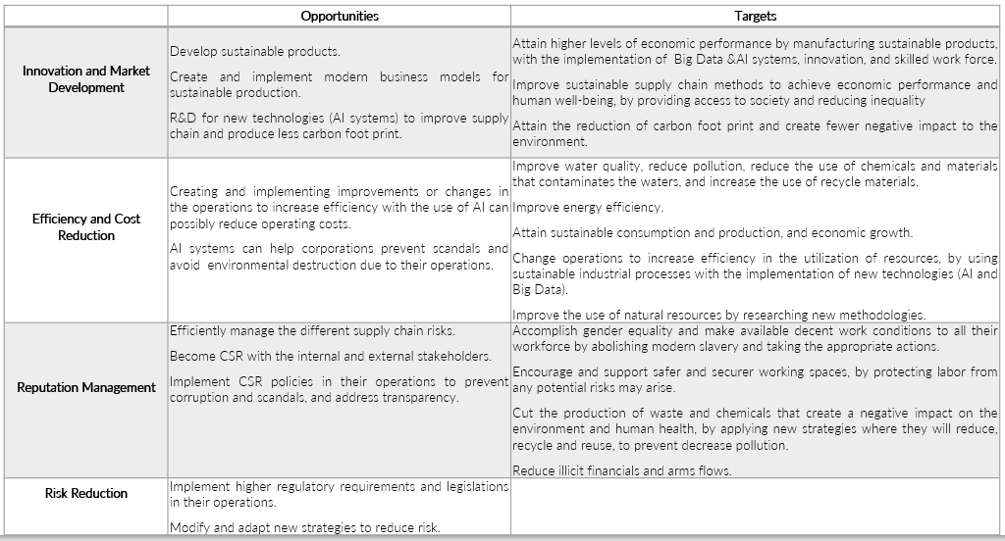
In the production sector, corporations are trying to achieve SDGs by modifying their strategies, goals, and operations with the use of AI technologies to provide innovation, expand into new markets, improve efficiency, reduce production cost, develop reputation management, and reduce risk.

Slide 8
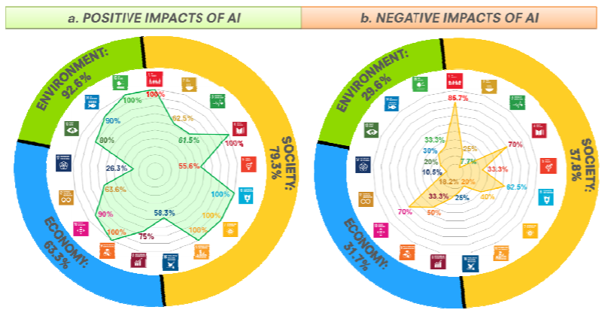
Positive and Negative Impact of AI
AI IMPACT ON SDG´S FRAMEWORK
AI may cause a positive impact on 128 targets (76%) defined across all SDGs, mainly through the implementation of technological enhancements which enable society, governments, corporations to overcome certain limitations. However, 58 targets (34%) across all SDGs may be affected by the negative impact from the development and incorporation of AI into our daily activities.
Notes:
Vinuesa, R., Azizpour, H., Leite, I., Balaam, M., Dignum, V., Domisch, S., ... & Nerini, F. F. (2020). The role of artificial intelligence in achieving the Sustainable Development Goals. Nature communications, 11(1), 1-10.

Slide 9
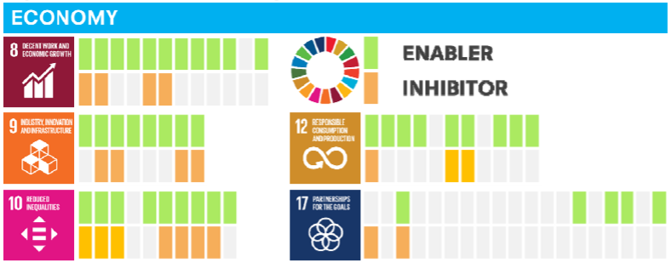
Impact of AI on Responsible Consumption and Productions
AI IMPACT ON SDG´S FRAMEWORK
AI has clearly net positive impact on the achievement of sustainable production and consumption, by supporting the creation of low-carbon systems, smart circular companies that use efficiently the resources available.
AI could help analyze large-scale databases to develop actions and strategies that aim to encourage the sustainable production.
AI enable technologies associated to the increase of productivity and inequality.
If the future global economy relies heavily on the use of data, and the distribution of these resources are not equally distributed it will generate future economical gaps (inequalities) affecting the development of certain SDG´s.
However, AI can help identify sources of inequality, by potentially reducing them with the use of virtual simulations on how society may behave given certain factors and challenges.
Notes:
Vinuesa, R., Azizpour, H., Leite, I., Balaam, M., Dignum, V., Domisch, S., ... & Nerini, F. F. (2020). The role of artificial intelligence in achieving the Sustainable Development Goals. Nature communications, 11(1), 1-10.

Slide 10

Responsible Enterprise
Manufacturing processes as well as supply chain methodologies have faced certain challenges, which transformed the business environment, by implementing AI systems & Big Data, where firms are service-oriented and products in the market have a short life cycle.
Enterprises are required to develop and decide on strategies regarding to inventory control policies, just-in-time solutions, data flows management and partner selection in order to fit in the requirements of the ever-growing global market.
The design of an appropriate supply chain network and strategy shall require the integration of economic, environmental and social aspects. So, the changes and adaptations of the operational systems should go through using AI systems to develop a closed-loop supply chain strategy which will result in the attainment of environmental sustainability.

Slide 11
Responsible Enterprise in Practice
01 (Take - make - waste)
It describes the sequence of actions from obtaining the raw materials from the supplier, transform it and manufacture the products in the factory, use distribution channels to sell them to the potential customers, and after they will convert it into waste. It is linear as it does not have a network and systematic logic.
02, The communication and collaboration between the stakeholders and the corporation are easy and straight forward. It is a relatively simple method or strategy to implement and use, as it helps businesses to grow and produce record breaking volumes, while tracking the progress of its implementation. Finally, it allow corporations to cover the present demand.
LINEAR SUPPLY CHAIN
04 Corporations do not reuse and recycle the waste, as well as it stops them from expanding in their operations in the long term. This strategy is inefficient and unsustainable, since the manufacturing operations produce large amount of waste as well as pollute the environment and produce a negative impact on the environment. These consequences are making this method to come to an end, since businesses cannot join forces with other corporations, and their current actions do not allow them to restructure their production process and find new business models with the use of AI systems.
03 In the actual business environment, corporations are facing a mayor problem that is the scarcity of resources, since the number of resources is limited, and they are coming to an end. The use of this strategy does not contribute with the 2030 agenda, since they do not practice sustainable production, and doesn´t encourage business to create sustainable products and develop new ways to produce less Carbon footprint.

Slide 12
Responsible Enterprise in Practice
01 It refers to the process of obtaining and processing the raw material into a product on the manufacturing site, equally distributed among the different distribution channels, so consumers can use it, and stablish a recycle and reuse process for the waste generated by their operations and consumers. The use of the closed loop strategy grants business to have unlimited resources, grow and become sustainable enterprises in the long run, while meeting the current demands of the market and the new trends.
02, The transition to a circular supply chain shall happen when enterprises move from only making products and selling it, to a product as a service corporation where they are directly involved in the production, maintenance, repair, installation, and reclamation of the given products throughout its lifecycle, as well as it will be executed with the use of AI systems.
CLOSED LOOP SUPPLY CHAIN
04 The creation of new business models allows them to meet with the current demand, find solutions and produce a new range of products, while causing less negative impact from the production and consumption of that given product. However, they are forced to implement AI systems and Big Data to effectively incorporate this strategy into their current operations and find alternative ways to produce better quality products at a lower cost with the use of data analysis. Finally, they require the time and resources available to implement this methodology.
03 Encourage enterprises to find alternative ways to sustainable produce it´s range of products, by helping them to implement AI technology to restructure their entire operation and system. The incorporation of AI and Big Data allows them to create and become sustainable enterprises and produce sustainable products, since these systems will encourage them to use the data available to design the entire operations. It´s operations will force them to reuse and recycle their waste and products, bringing them new opportunities, such as sustainable growth, new resources, lower operating costs, innovation, reputation management and reduce potential risks.
Notes:
Governance: Change Management

Slide 13

Main Use Cases of AI in Consumption and Manufacturing
Production Optimization + Predictive Yield
Predictive & Preventative Maintenance
Supply Chain Optimization
Notes:
In general, these are the main use cases of AI

Slide 14
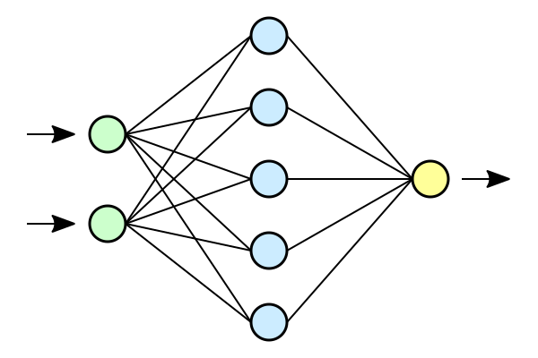
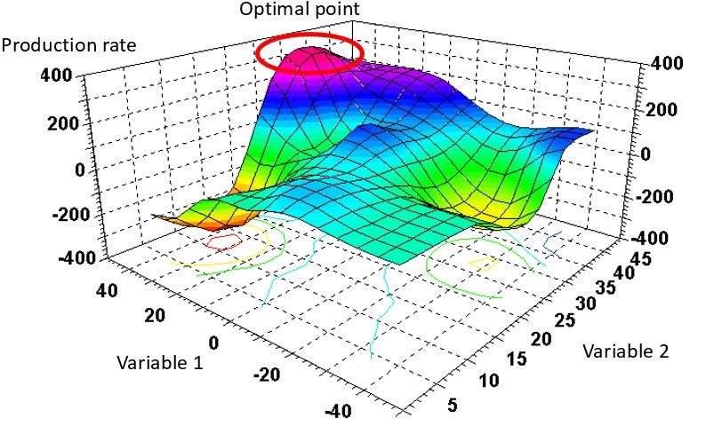
Production Optimization
+ Predictive Yield
Predictive Intelligence:
Neural Networks + Deep Learning
Prescriptive Intelligence: Multi-Dimensional Optimization Algorithms
Deal with complex features in big data
Handle internal and external factors
Improve with changing and steaming data
Analyze historical datasets
Models important variables to predict the most optimal production possible
Eliminate Waste
Improving Yields
Increase Resource Efficiency
Saving Time and Money
Notes:
https://towardsdatascience.com/machine-learning-for-production-optimization-e460a0b82237
Multi-dimensional optimization algorithms
“1. Prediction algorithm:
Your first, important step is to ensure you have a machine-learning algorithm that is able to successfully predict the correct production rates given the settings of all operator-controllable variables.
2. Multi-dimensional optimization:
You can use the prediction algorithm as the foundation of an optimization algorithm that explores which control variables to adjust in order to maximize production.
3. Actionable output:
As output from the optimization algorithm, you get recommendations on which control variables to adjust and the potential improvement in production rate from these adjustments.”

Slide 15

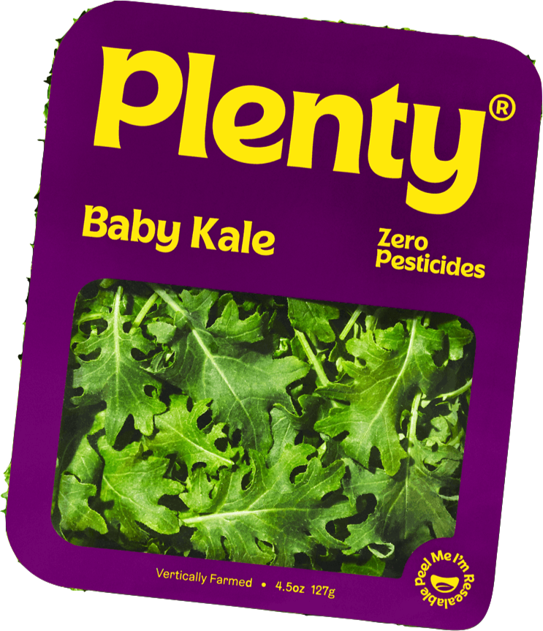
Plenty: Vertical Green Farms
“Imagine a 1,500-acre farm. Now, imagine that fitting inside your favorite grocery store, growing up to 350 times more. That's efficient.” Nate Storey, Founder of Plenty
Uses genetic algorithms and neural networks for production optimization
Generates optimal yield for production and consumption
Times production so the greens are ready just in time
Uses 99% less land and 95% less water to produce same product
Consumes large amounts of energy, due to LED lights and computing power
Provides an option to solve the upcoming food crisis
Notes:
“AI monitors growth patterns and constantly adjusts environmental factors such as temperature, water and light patterns to ensure ever-more efficient and economical output.”
“Sunlight is emulated by LED panels, so food is grown in optimal conditions 24/7. And water is recycled and evaporated water recaptured so there is virtually no waste”
https://techxplore.com/news/2020-12-ai-controlled-vertical-farms-revolution-food.html

Slide 16

Predictive Maintenance
… instead of Preventative Maintenance
Predictive Intelligence:
Neural Networks + Regression
Uses a Network of IoT Devices
Devices get repaired when they need it, not on a schedule, saving money and time for the company
Applications across the supply chain
Manufacturing Efficiency
Streamlining Delivery
Ensuring Product Quality
Notes:
https://beyondminds.ai/blog/predictive-maintenance-using-ai-to-take-manufacturing-a-big-step-forward/

Slide 17

US Air Force x C3.ai Inc
Project to install IoT Sensors on all Air Force aircraft to implement predictive maintenance
Using C3.ai’s solution, the Air Force is able to:
Process handwritten notes on aircrafts using natural language processing
Ensure aircraft safety while not wasting excessive resources on planned maintenance
Reduces delays in the USAF’s international supply chain by eliminating unexpected accidents and repairs

Slide 18

Supply Chain Optimization
Inventory Management
Predictive Intelligence
Managing complex and constantly changing inventories
Streamlining Logistics
Prescriptive Intelligence
Choosing shipping routes and strategy
Purchasing Strategy
Predicting future need for resources
On-Time Delivery
Lean management
Resource efficiency

Slide 19


Slide 20

About Us
The o9 Digital Brain
‘
‘
‘
‘
Businesses that plan better, reduce waste, creating value for themselves and the planet.
- o9 Solutions
Faster, more intelligent planning and business decision-making translate directly to better financial results – i.e., being able to deliver on the business plan. But it means much more. Global supply chains are the largest consumers of the Earth’s resources. Nearly 1.3 Billion tonnes of solid waste is collected worldwide. This figure is expected to increase to 2.2 billion tonnes by 2025.
Therefore, good planning means enterprises are able to achieve their goals while using less of the Earth’s precious resources. . o9’s AI-powered platform aka “Digital Brain” is helping global enterprises develop and implement their AI strategies. The integrated planning and operational efficiencies o9 provides is helping businesses do more, be more and mean more to the world at large.

Slide 21
AI STRATEGY FRAMEWORK
BUSINESS VALUE
o9 was born to bring together some of the world’s best technology, planning and industry experts on a mission to create the most value-generating enterprise software platform.
USAGE
Detecting market changes, forecasting demand accurately, and driving integrated commercial, supply chain and financial plans and decisions at the speed and scale needed to compete in the digital age
AI AMBITIONS
Leverage real-time data, both internal and external, to sense opportunities & risks.
Uses analytics, AI, and algorithms to transform data into knowledge
Connects all planning on one single platform to enable true end-to-end decision-making
Significantly improve on their material requirement planning, production planning, logistics cost, inventory (holding) cost which creates a total upside in terms of revenue and reduces write-offs in terms of obsolete inventory
AI MATURITY
o9’s technology is future-proof, incorporating technological advances that will be more and more critical over time (cloud-native, big data integration, graph database, R- and Python plug-ins etc.).

Slide 22

They are on a mission to develop the best platform and solutions to help enterprises in this critical pursuit.
Hello
THE O9 DIGITAL BRAIN IS THE ULTIMATE PLATFORM TO TRANSFORM PLANNING AND DECISION-MAKING
O9’s AI-POWERED PLANNING AND DECISION-MAKING PLATFORM THAT UNLOCKS THE 6 CORE CAPABILITIES OF A DIGITAL OPERATING MODEL
01
02
03
04
05
06
REAL-TIME MARKET KNOWLEDGE
AI/ML POWERED FORECASTING
MERCHANDISE ANALYTICS, PLANNING & GAP CLOSURE
SUPPLY CHAIN ANALYTICS, PLANNING & CONTROL TOWER
DIGITAL INTEGRATED BUSINESS PLANNING
E2E DIGITAL COLLABORATION

Slide 23



Digital Brain: Knowledge Powered Analytics, Planning and Decisions Platform
Digital Customer Engagement
Integrated Planning & Decisions
Digital Supplier Engagement
Integrated Business Planning
Demand Planners
BU / P&L Owners
AOP
LRP
Finance
Supply Planners
Sales & Operations Planning (S&OP)
Store Collaboration
Revenue Management
Supply Chain Management
Tier 1 Collaboration
Revenue Planning & Budgeting
Centralized Forecasting
Supply Chain Master Planning
Rogers.com
Marketing & Trade Promotions
Pricing
NPI
AI / ML Forecasting powered
Demand Planning
Distribution
Production
Procurement
Revenue Control Tower
Supply Chain Control Tower
Tier 2 Collaboration
Retailer Collaboration
Analytics
Commercial Analytics
Demand Analytics
Supply Chain Analytics
Initiative ROI | Assortment | Product Portfolio | NPI | +
AI/ML Forecasting | Demand Segmentation |+
Cost-to-Serve | Inventory | Planning Policies | +
B2B Collaboration
CM Collaboration
Enterprise Knowledge Graph
Market Knowledge Models
Demand Knowledge Models
Supply Chain Knowledge Models
Competitor Intelligence
Forecast Accuracy
Segmentation
Channel Intelligence
Halo and Cannibalization
Lead Times, Capacities
Commodity Intelligence
Supplier Intelligence
Customer Intelligence
Initiative ROI
New Product Ramp Curves
Market Size
Sales Plans
Demand Forecasts
Orders
Supply Allocation Plans
Resource Plans
Procurement Plans
Events
Consumer Sentiment
Market Share
NPI Plans
Distribution Plans
POS
Assortment Plans
Pricing Plans
Demand Priorities
Inventory Plans
Make Plans
Channel Inventory
Initiative Plans
Consumers
Market Regions
Distributors
Sales Accounts
Ship Tos
Factories
Source Activities
Demand Drivers & Market Knowledge Stream
Move
Supplier Nodes
Supply Chain Knowledge Stream
Products
DCs
Make Activities
Material Hubs
Retailers
Initiatives
Move
Supplier Nodes
Competitors
Online
B2B
$$
People
DCs
Budgets
Make Activities
Web Scraping
Natural Language and Image Processing
Spreadsheets
IOT Hub / Edge APIs
Enterprise APIs (ERP, DW, CRM, PDM..)

Slide 24
HIGH-LEVEL APPROACH
Project Phases
High-Level design
Sprints
Test
Go-Live
Hypercare
Sample Data Set Ingestion
Configure
9
Data Needs and Collection
4
5
Generate Sprints
UAT
8
SIT
Value Tracking
10
11
3
Sprint Plan
Agile Build
6
Design
Unit Test
7
Full Data Set Loading
Roll-out
Define user Stories
2
Priorities Sprints
Typically 3 Consecutive Sprints
1
Understand detailed requirements and value leakage
Review
Application of agile methodology across the project to ensure efficiency as well as flexibility during the delivery of the solution

Slide 25
BUSINESS CASE
One of the largest companies in beauty and personal care
Context
0
Approach
Benefits
Situation before o9
Scope of the o9 implementation
Impact
Client was unable to sense demand/supply disruptions in the supply chain in a timely manner
Furthermore, they were unable to translate and evaluate disruptions in order to provide a real-time response
The marketing, sales, finance and supply chain functions were operating in relative silos, having their own assumptions and versions of the truth
With the o9 Control Tower, client was able to spot risks and opportunities much faster due to the ability to connect to many (unstructured) internal and external data sources
The o9 platform has helped to sense, translate and evaluate those risks and opportunities. Thus, advising users on what to do in order to solve the sensed disruptions
Client used the o9 Enterprise Knowledge Graph to sense and respond to demand and supply disruptions in real time. This allowed them to run the entire Control Tower and IBP processes on a single integrated collaborative platform, bringing one single source of truth
5-7% increased forecast accuracy that in-turn reduced production wastage.
Faster response to risks and opportunities resulted in an improvement of top-line sales and a reduction of inventories
Better and faster decision-making resulted in increased productivity
Reduction of non-standard supply chain costs (flex, expedites, alternative sourcing) through better planning

Slide 26
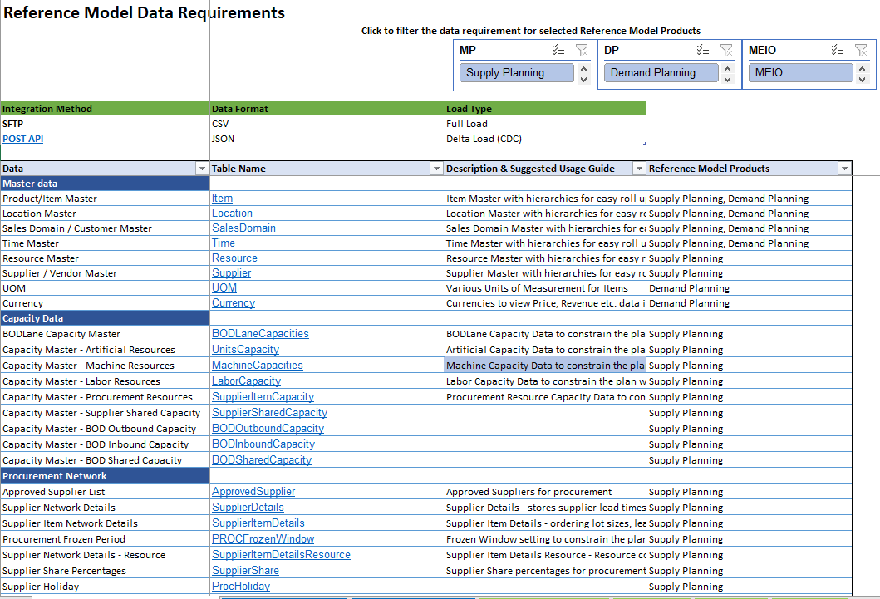
DATA ACCESS

Slide 27

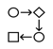







DATA ACCESS
Data Source – o9 Integration Architecture
Source Database
o9 Cloud Tenant
PI/PO - or alternative middleware or cloud based integration solution i.e Azure / GCP based integration
custom built algo’s (client’s IP)
SSL Exchange for API
SFTP for IDOC transfer
Workflow
PI/PO
Solutions
Data Sources
AI Powered Enterprise Knowledge Graph
A
Apache Nifi
Apache Spark
Transactional Data (‘Live’ orders, STR, STO, etc.)
IDOC >> API
RFC call (sync)
Transactional data -
high refresh rate / variability
Data Exchange (REST API)
D
ETL - Big Data Stack
C
real-time / near real-time
synchronous
Integration Options tailored to requirements and capabilities
Master Data / Historical Delta
Real-time & high frequency data integration via nifi pipelines
Time Consistent
Data
Historical Transactions
Data
B
IDOC >> SFTP
Batch Ingestion - ETL data loads
Data Ingestion
(SFTP)
ETL load & Data cleansing
Master / Historical data -
low variability / high volume
SAP Master Data
Batch & high volume ingestion via ETL & big data pipelines
Real-time synchronous data exchange of transactional data via REST API calls to RFC or IDOC exchange.
Batch data - high volume / low volatility direct ingestion to o9 via SFTP exchange (IDOCs FF) .
Batch deltas can be uploaded via either real-time synchronous exchange or incremental ETL depending on size and frequency of data set.
o9 Data integration consolidation and validation via Apache nifi for streaming and real time updates. Big data processing and data cleansing for ETL loads
A
B
C
D

Slide 28





DATA ACCESS
Data Governance
Challenges
To ensure Data availability and quality, o9 establishes data governance processes based on the maturity of source system. However, it is still anticipated that data quality of master data and transactional data to support AI solutions will be challenging.
Mitigation Approach
Formal data readiness assessment before implementation begins.
Resolve key data availability and quality issues before or during implementation project.
Data validation reports sent in an email / dashboards for IT teams
Data Exception alerts generated to key users

Slide 29



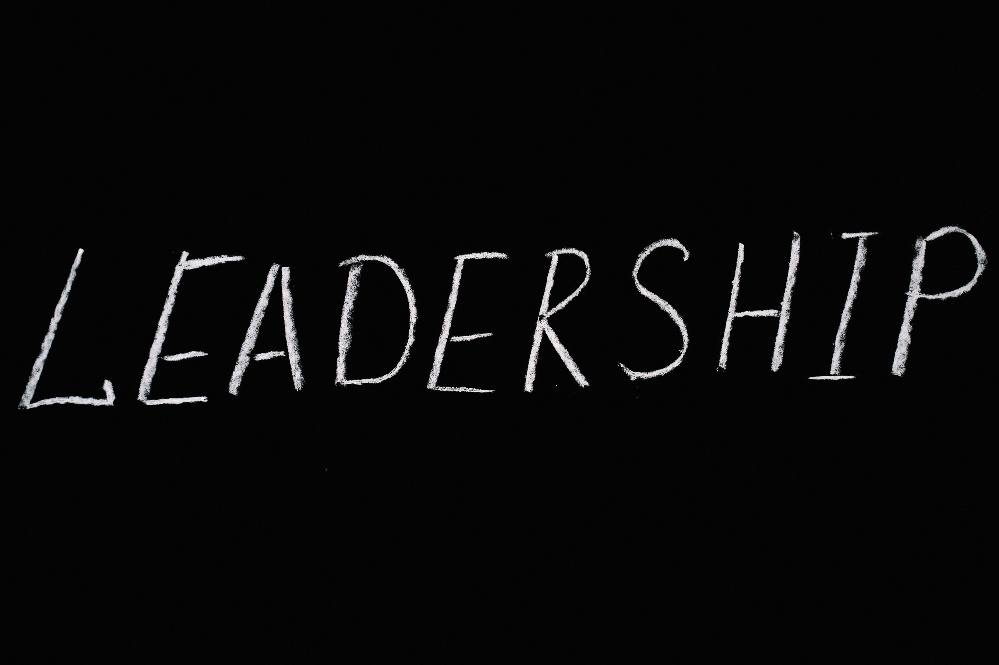
AI OPERATIONS
‘
‘
Our world class experts in planning and process design challenges clients to not just incrementally improve existing processes but apply new thinking and new capabilities to achieve their vision of a new digitally connected operating model.
‘
‘

Slide 30
O9 AI Specialists and their responsibility
 | Executive Alignment and Thought Leadership (Client Partner) | Overall success of the program Value delivery Provide inputs into change management
 | Program Management (Project Manager) | Jointly develop and manage the work-plan Provide inputs into the status report, issues and risk management Interface with client on meeting schedules, action items, follow-up, pre-reads etc.
 | Process Design (Solution Strategist) | Understand the end-to-end business process Jointly design the to-be design for the process User engagement & sprint reviews Interface with Training and Change Management
 | Solution Modeling & Configuration (Solution Architect and Application Engineers) | Drive the solution design and data requirements Deliver the configuration; Work with business on adoption and best practices Data Analytics to drive Business Insights
 | AI/ML Modeling (Data Scientists) | Configure & Tune Pre-packaged AI/ML Models Develop new AI/ML Models
 | Integration and Data Processing (Integration Lead & Integration Engineers) | Load and message data Manage data quality

Slide 31
O9’s client AI Specialists and their responsibility
 | Executive Alignment and Thought Leadership (Executive Sponsor) | Assures project visibility and supports overall success of the program Helps resolve cross-functional issues, provides direction and support for project team
 | Program Management (Project Manager) | Directs the day-to-day activities of the project team's efforts Provides support and direction for project team
 | Process Design and Change management (Super User) | Acts as a go-to person for end users during rollout Performs detailed design validation and pilot testing activities Represents the business needs throughout the project lifecycle
 | Solution Modeling & Configuration (Subject Matter Expert) | Engaged in the project as needed to provide inputs to the solution design Reviews functional requirements, validates prototype, prepares test scripts, Supports end user training and involved in post go-live support
 | Analytics and Decision Scientists (Business Analyst/ CoE) | Data Analytics to drive Business Insights
 | Integration and Data Processing (IT Analyst) | Develop any interfaces to provide data to o9 Manage data quality

Slide 32
Program Governance Model
As Needed
Executive Sponsors
Program Executive Sponsor
Review Program Status Overview
Advocates for the program
Resolve Any Strategic and Alignment Issues
Manage Use of Contingency Funds
Provide project Stage Gate Approval
Quarterly
Executive Steering
Review Program Status; Timeline, Financials, Deliverables, Business Alignment, Issues / Risks
Recommend Resolution Of Strategic and Alignment Issues
Recommend Stage Gate Approval
Resolve most Issue Escalations
Bi-weekly
Project Steering
Complete project milestones per timeline
Conduct deliverable and stage gate reviews with SMEs
Escalation of issues / risks to project steering team
Daily
Project Team

Slide 33
Process industrialization
Implementation using Hybrid Agile Methodology to ensure scalability and efficiency
Agile MVP provides swift value (low effort, high value)
Choosing MVP release to appropriate business unit to reduce risks
Improve – Learning from MVP and Continuous improvement to incorporate user feedback and more advanced capabilities
Scalability – After MVP success, roll out to other business units
Iterative sprints of quick configuration and user reviews
Setup of a CoE (Center of Excellence) at the client organization to lead on-going AI development and maintenance
Agile MVP
Roll Out
Roll out to other regions/categories
Release
Each Business Release enables one or more decisions
Deliver continuous enhancements
Improve
Each Business Release has multiple agile sprints
High Level Design
Test
Go Live

Slide 34
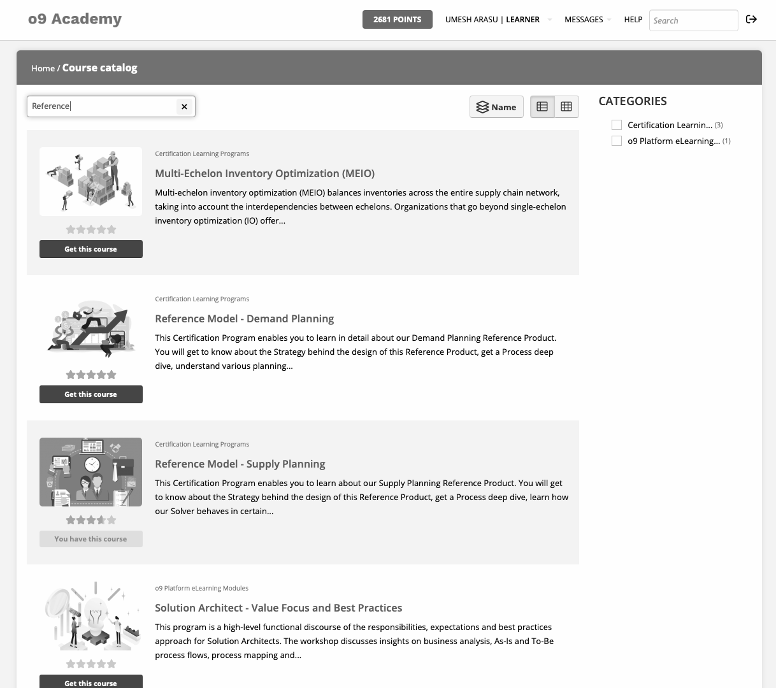


AI Culture
Training & Education
o9 Academy digital learning courses are available for services teams to learn what’s new with each reference product release
Reference model courses with varying levels of details from basic to advanced are available for partners and customers
LMS Courses on: Platform Series Data Science Series Solver Series Reference Product Series Supply Chain Basics Series o9 Methodology Series | Upcoming LMS Courses: Micro Master Programs Sales/Pre-sales Series Overview Series AoTP Series o9 Processes Series
22 Badges

Slide 35

O9 Workshops
Training on best of breed o9 Reference products, encapsulating best practice data models & workflows
Expert-led immersive, hands-on training for fast-paced learning & ramp up.
Highly recommended in preparation for o9 implementation Blueprinting. Post-training team members are better equipped for solution design and configuration Sprints
Increase knowledge, skills & engagement of business and tech teams, lay foundation for successful implementation and adoption.
Collaborate, learn and network with diverse groups of experienced practitioners

Slide 36
Preparing for Change: Create compelling video-based communication for building organizational alignment
“Case for Transformation” videos & demos
“What is in it for me?” stakeholder videos & demos
Compelling videos highlight current state challenges, business case, and competitive necessity for change
Executives from sales, supply chain, and P&L functions participate in the videos, establishing this as a strategic priority for the company
“art of possible” Demos
Especially for Sales, P&L owners, so it is not a supply chain only initiative
Compelling Videos for Sales, P&L teams on how this will make their life easier by reducing time spent on “non selling” activities
Reduce time spent on forecasting – System generated forecasts
Get pro-active visibility to order supportability – Don’t have to chase people
Demand shaping guidance from supply chain on opportunities
Early warnings on risks to the financial plan, enabling faster corrective actions

Slide 37
Critical Tracks to change management during o9 implementation
4 key factors have to be designed into the renewed process and system to facilitate change and continuous improvement
01 Selection of Pilots – Critical to choose segments with leaders who are evangelists
When selecting pilot markets or supply chain segments in initial phases of implementation, choose segments with change minded and dynamic leaders
They need to be evangelists for change within their org, as well as to broader organization upon pilot success
02 Design of transparent planning policies to drive right behaviors across sales and supply chain
Policies should drive behaviors that encourage early warning and high level of say/do accountability ex:
Plan misses – When did we first know? Could we have known earlier?
Higher allocation priority for markets/accounts with better forecast accuracy
Supply chain should respect prior commits over incremental new demand
o9 Implementation
Design for Change & Continuous Improvement
04 Cloud based training & ongoing education designed into the platform
With cloud platforms, capabilities are never static, new capabilities are continuously delivered
Users need to be trained periodically on new capabilities as they are delivered – Cloud and video-based training, certification has to be designed into the platform
03 Implement KPI leaderboards & post game analytics to drive continuous improvement
KPI leaderboards have to be implemented for sales accounts, markets, supply chain, factories, procurement
KPI leaderboards drive peer comparison and highlight who is performing well and who is not relatively – ex: Account 1 has 80% Sales forecast accuracy, account 2 has only 50%. What is account 1 doing better?
Executives need to use leaderboards in IBP meetings to drive accountability for improvement

Slide 38




Maturity Assessment
AI Culture
Business Value
Very Matured
Very Matured
AI is an integral element of the company culture
O9 is constantly driving value for businesses and innovating their platform through AI
AI Operation
Data Access
Very Matured
Matured
Operations are organized to maximize AI capabilities & innovations
Policies are in-place to manage, use and access the data

Slide 39



The Role of Consumer
The global population has been increasing throughout the last couple of years, as well the global economy and the use of new technologies.
Consumption is an essential element inside the supply chain and sustainable production of goods because if there is no consumption, corporations will not have the motive and incentive to produce their goods
Consumers have shopping behaviors that vary depending on the selection of the products, price, quality and value of the goods. Is essential that consumers get involve in the innovation process and pressure enterprises to invest in innovation to create sustainable products.
Environmental impact (I)= Population (P) x Affluence (A) x Technology (T)
Consumption is good since it contributes with the economic growth of the global economy. However, it can turn into an issue if the society shift into consumerism, meaning customers are getting goods and services in an ever-greater amounts. This shift into consumerism is the result of a range of factors that promote unsustainable consumption: competition, modern economy, materialism.

Slide 40
The Role of Consumer
SDG´s and the 2030 Agenda will not be completed if consumers fail to change their way of thinking and do not start behaving ethical, by decreasing the levels of consumerism. Meaning, individuals need to incorporate sustainable consumption in their daily activities, as well as encourage enterprises change their current supply chain strategy.
The global economy is shifting from the old values to the new values to achieve the 2030 Agenda, by incorporating sustainable practice in their daily operations and creating sustainable products, process, and development.
Consumers
To address sustainable consumption, arrangements between consumption, resources and environmental impacts need to be done first, to cause shifts on the market mechanisms of consumption patterns, as well as developing new concepts of wealth and prosperity.
Consumers can either have an ethical or unethical behavior depending in depending if they practice unsustainable or sustainable.
The shift of consumer behavior into sustainable consumption, carries new opportunities to business if they adapt to the new changes and faced the challenges in the best way possible by incorporating sustainable supply chain strategy and AI systems. Enterprises will be able to progress into new markets and modify the existing ones with sustainable products, as well as offer services for the product they sell

Slide 41

Summary and Recommendations

Slide 42
Competition fosters unsustainable behaviour
Structured of Modern economy encourages unsustainable consumption
We define ourselves by our possessions
Problem
Companies are exposed to a competitive market system, where they are in the need to design strategies and take actions in order to survive and continue operating in the market. However, this competition encourage firms sometimes to adopt certain unsustainable behavior, as well as some do unethical practice to compete against it´s competitors. In this modern economy firms find ways to reduce cost and provide products with low prices in order to obtain customer loyalty and compete with the other firms in the market. The reduce in operational cost can make business take actions that are consider unethical like: child labor, slavery, inequality, selection of suppliers that also work unethical and unsustainable manufacturing process, where all these actions have a negative impact on the society and the environment.
Enterprises work to become the market leaders in their industry and obtain most of the market shares. Therefore, companies try to provide lower prices and develop new products to satisfy customer needs, as a result this creates unsustainable consumption, as consumers work develop the necessity of wanting and needing the given product. Also, consumerism do not encourage consumers to recycle and reuse their old items, they only just want to acquiree more and more products, and as a result this behavior from companies and consumers generates large amount of waste that have negative impact on the environment.
The new market trends have encouraged the society to become materialist. This implies, that consumers also compete between them to show who has the best item, the most modern and innovative product. This creates overconsumption as consumers only want to have the latest trends. In addition, most of the consumers do not have the incentive to recycle and reuse their old items, instead they acquire new products every day, so this behavior creates large amount of waste which is increasing significantly. Unsustainable consumption have a negative impact on the environment, society, and exhort corporations to behave unethical and continue with their current unsustainable production.
Solution
Corporations need to start changing their current strategies and shift from linear supply chain to circular supply chain to create a sustainable production and manufacture sustainable products, as well they are required to encourage customer to adopt sustainable consumption.
External Stakeholders should pressure corporations to start adopting an ethical behavior and incorporate sustainable practice in their supply chain and operations. Finally, individuals not only need to pressure corporations to become CSR, but they also need to help them with the changing process and give them incentive to change their operations by rewarding them.
Corporations are required to encourage their customers to shift from unsustainable consumption to sustainable consumption. This action will take place when corporations adopt closed loop supply chain strategy and make their customers aware of the adoption of this strategy.
The society need to watch and learn how their daily actions have an impact on the environment and start making the necessary changes to decrease the impact it´s actions create to the environment. The change will start when the humanity start changing their behavior patterns and start recycling and reusing goods instead of new ones every time.
Promote a sharing economy.
Individuals should change the current standards imposed by society in terms of how we define ourselves by our possessions and the perception we have toward our impact on society and the environment.

